Slide 1
Cat Tracker
Steve Kennedy
NetTek Ltd

Slide 2
What’s it all about?

Slide 3
The hardware
1.8 x 1.2 x 0.5 inch
USB 1.1
Logging and charging
SkyTraq Venus 5 chipset
Sirf3, patch antenna
Battery 230mA
runtime approx 30 hours with a 30s interval time
Logging 1s to 60m
Capacity 16,000 waypoints

Slide 4
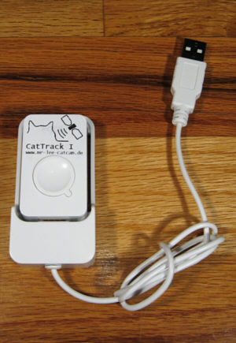
The hardware
Water resistant moulding
Comes with USB “dock”
2 status LEDs
Can be disabled when tracking

Slide 5
Attaching to cat
Can be attached to collar
Cat Harness recommended
GPS always faces sky
Silicon mount attaches to harness
Cat Tracker fits into mount

Slide 6
Attaching to cat

Slide 7
Using the data
Windows software supplied
Gets data off Cat Tracker
Data compatible with Google Maps
See where your cat’s been

Slide 8
Cat Track Live
Contains GPS and Quad band GSM/GPRS
1.8x2.5x0.65 inches
800mAh battery
Approx 48 hours use
“Programmed” via SMS
Can send GPS data on demand or on set periods
Has built-in microphone
Can call and listen

Slide 9
Cat Track Live
Geo Fencing
Send unit top left and bottom right lat/long
If unit moves out of area, SMS with location is sent to authorised numbers
Move alert
Unit stationary then send movement command
If movement unit will indicate with position
Speed alert
If the device moves above a set speed, it will send an alert indicating speed and location
SOS
If the SOS button is depressed for more than 3 seconds, unit will send out an alert and location.
Low Battery alert

Slide 10
Costs
Cat Tracker $46
Cat Harness $6
Cat Track Live $135
Available from http://www.mr-lee-catcam.de/

Slide 11
Future
Develop kinetic charger
Like Seiko/Citizen watch systems
Indefinitely track objects
Used to be very difficult as GIS systems were expensive
Google/MS/etc have made the technology easy
Now relatively easy to develop real-time geolocation based systems
Many GSM/GPRS chipsets have built-in TCP/IP
Use a high level programming language like Python
i.e. unit can connect back to server over IP to report it’s position (low cost)
Back-up over SMS

Slide 12
Thank you for listening!
Email: steve@nettek.co.uk
p.s. No cats were harmed in producing this presentation

